Slide 1
Critical barriers precluding the electrification of road public transport: Locarno case study
José Veiga Simão, Francesca Cellina, Roman Rudel

Slide 2
Electric bus powertrains have recently gained momentum
©greenarcongress.com

Slide 3
Electric bus types
Overnight charging Charging in the depot Large battery (max 4 to 5 t) Range per charge: today about 120 km, in the future 300-350 km Charging power up to 150 kW Charging duration 3 to 5 h (depending on the route length) |  | Opportunity charging (static) Charging on terminus stations or on stations on the route Small battery (<1t) Range per charge 20 to 30 km Charging power: 450 to 600 kW Charging duration: 3 to 6 minutes at 450 kW, 0.5 to 1 minutes at 600 kW (depending on the route length) |  | In-motion-charging (IMC) Charging on overhead lines (system trolley bus or IMC) Small battery (<1t) Share of electrified route: 50 to 60% Charging power: 120 kW
“Combi-charging” Large battery (max 4 t) Charging in the depot and recharging at terminus stations very large reach already possible today (given enough time for charging on terminus stations)
Today there is no «one-size-fits-all» solution for every bus service Every bus company has to study what is the combination of battery size and charging system more suitable to each line

Slide 4
Case study
Public transport company of Locarno (Southern Switzerland) - Ferrovie Autolinee Regionali Ticinesi
Explore the practical feasibility and costs of a possible purchase of a fleet of electric buses, at two main time horizons: 2021 and 2030
Focus on two urban lines:
flat route (maximum slope 4.2%) flat route (maximum slope 5%)
To guarantee the service for the two lines 1 and 7, the transport company plans to buy a number of buses equal to the number of shifts scheduled for 2021, plus one additional bus for each line, as a backup, meaning a total of 16 buses.

Slide 5
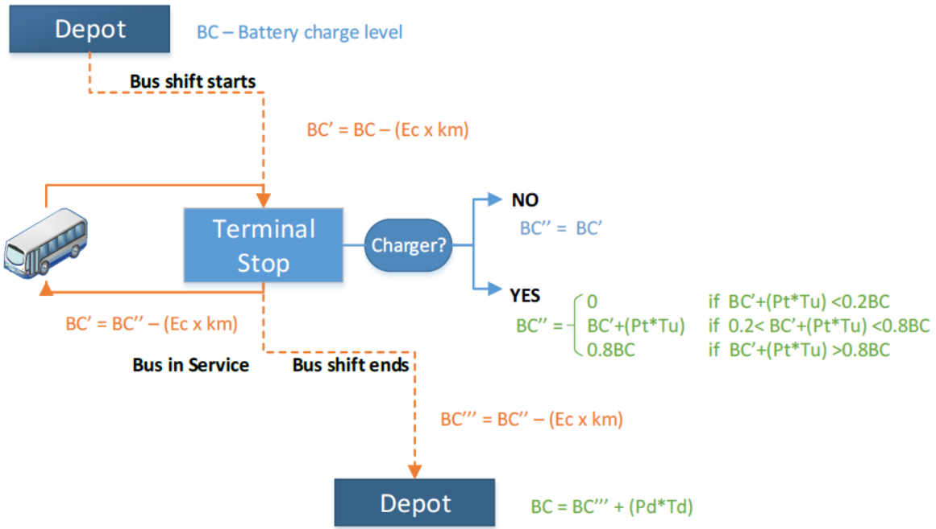
Methodology
Create a decision support system (DSS) that simulates the service of line 1 and 7 by estimating the «reliability of the service» and the «costs»
DSS scheme to simulate the reliability of the service
The DSS simulates:
Different types of e-buses
Service performances and costs on varying:
bus consumption per kilometer
battery capacity
number of terminal stops with fast chargers available along the line

Slide 6
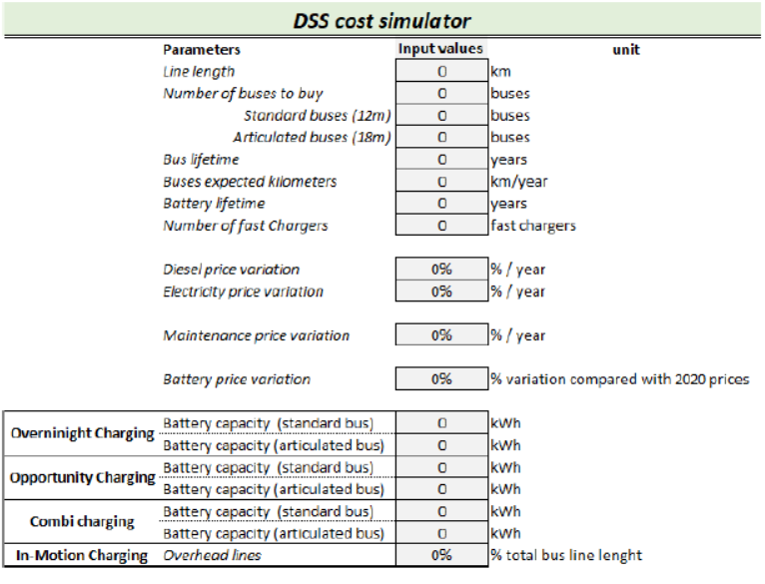
Cost simulator - Methodology
DSS cost simulator input parameters page
The DSS cost simulator allows to manually input some parameters and automatically shows the effects in terms of overall costs for a single transport line or for the overall fleet of a company
Infrastructure, bus, energy, and maintenance costs are estimated averaging the prices observed in the Swiss market
Costs of insurances, personnel and administration are instead estimated by referring to the cost of service budgeted by the Locarno public transport company for year 2021
External costs are not considered

Slide 7
Results – Feasibility analysis
Overnight charging is not feasible with the planned number of buses to buy. In fact, operating routes suitable to overnight charging schemes have daily shifts of 12 hours or less*, while here daily shifts are up to 19 hours
Opportunity and combi-charging schemes would run the service with the panned number of buses, however:
higher than three minutes delays at the terminal stops might put at risk the whole service
recharging power stations at the terminal stops are needed. This requires interventions on the grid such as the installation of new transformation substations and new power line cables, whose realisation could take 1.5 years
In-motion charging schemes would allow to perform the service, but:
need to perform roadworks for the aerial infrastructure (overhead lines)
the visual impact of the overhead lines might generate conflicts
interesting for cities where electric overhead lines already exist
*M. Estrada, J. Mensión, M. Salicrú, “Oppportunity charging of buses. Effects on bus operator costs and user performance” European Transport Conference 2017, October 2017

Slide 8
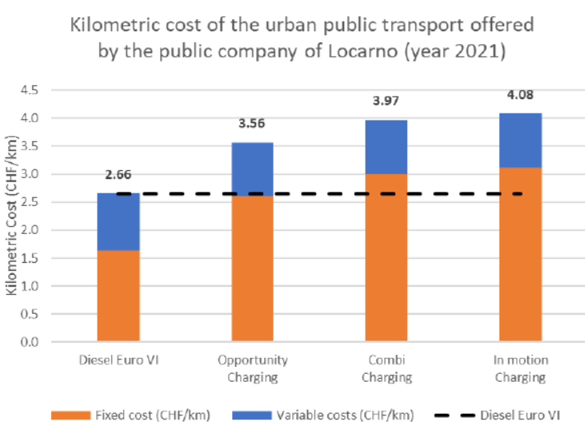
Discussion – Cost analysis – Time horizon 2021
Diesel Euro VI buses are currently the most economic option
All electric technologies are between 40% and 60% more expensive than diesel:
mainly due to fixed costs (especially buses and infrastructure depreciation cost)
only considering variable costs (energy and maintenance cost), electric buses have a comparable cost as diesel
diesel variable costs are artificially low: federal authorities give back the amount of the diesel custom duties, equal to 0.582 CHF/l

Slide 9
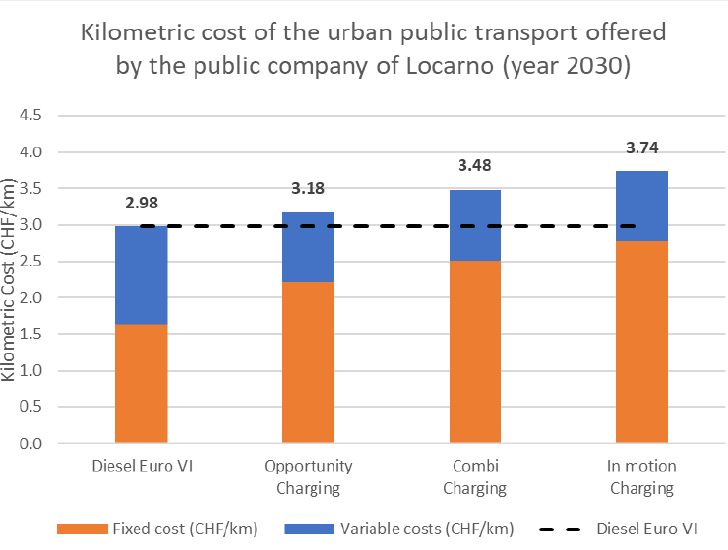
Discussion – Time horizon 2030
Progress in electric bus technology is expected to be fast, leading to:
a decrease in the cost of buses and batteries
an increase in the distance range per charge
an increase in the duration of batteries
Diesel Euro VI technology will remain the most convenient option
All electric technologies will be between 8% and 30% more expensive than diesel
Hypotheses for 2030 simulation:
Abolition of cashbacks for diesel custom duties
25% decrease in bus purchase cost by 2030
45% decrease in the second battery cost in 2036
Other costs are kept constand

Slide 10
Conclusion of the case study
In the case of Locarno, purely electrical powertrain bus models are not yet able to replace one to one the current diesel powertrain buses
Our analyses lead to identify the following barriers precluding a short-term bus electrification:
1. In the rush hour, car traffic-related delays are likely to hinder possibility to recharge at the terminal stops, which would stop the bus service;
2. Costs for infrastructures and purchase of electric bus are still too high;
3. Cashback of the custom duties on diesel artificially supports diesel powertrain;
4. Installation of fast charging stations requires time, therefore it has to be programmed well in advance (at least one year and half for authorisations and interventions on the grid);
5. The staff of the transport company, at all levels, need to be properly trained in order to adjust their skills (for instance, different “driving styles” and maintenance operations).

Slide 11
Policy recommendations for the electrification of road public transport
Stop the artificially low variable costs of diesel
Abolish cashback of the custom duties on diesel, or
Provide electric alternatives with comparable incentives
Introduce incentive packages to lower fixed costs
Germany subsidises up to 80 percent of the additional costs in the purchase price for an electric bus compared to a diesel model and infrastructure cost is covered by 40%
UK subsidises up to 75% of the cost difference between a zero-emission bus and a standard conventional diesel bus and infrastructure cost is covered by 75%
Set new regulations
In the Netherlands, from 2025 onwards all new buses have necessarily to be “emission free”, namely electric or fuel-cells

Slide 12
Policy recommendations for the electrification of road public transport
Rethink the overall service and adjust it to the needs by electric buses
Reorganize bus routes – E.g. Bus routes in Shaffausen (Switzerland) were re-drawn: they all pass through the central station, where recharging is easier, and cross the city with a “big 8” shape
New frequencies – allow for more stop time to recharge at the terminal stops
Introduce dedicated bus lanes – to reduce the risk of delays due to traffic congestion
Support transition studies for local transport companies
Canton Ticino (Swiss region) has subsidized and followed closely this study
Create an «Electric bus information hub»
provision of national/international examples and best partices
set a pool of local/national experts to help local companies with
studying the best alternatives
change management
procurement of buses and infrastructure
staff training

Slide 13
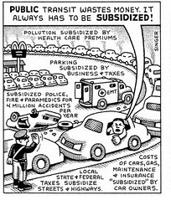
Thanks for your attention!
José Veiga Simão
SUPSI – DACD – ISAAC
jose.simao@supsi.ch
T (+41) 58 666 62 82

