Slide 1
Close your eyes and open your mind.
A practice-based experiment of cultural mediation for visually impaired people.
Jean-Pierre Canderolo, Luca Morici, Valeria Donnarumma, Marta Pucciarelli
University of Applied Sciences and Arts of Southern Switzerland (SUPSI)

Slide 2
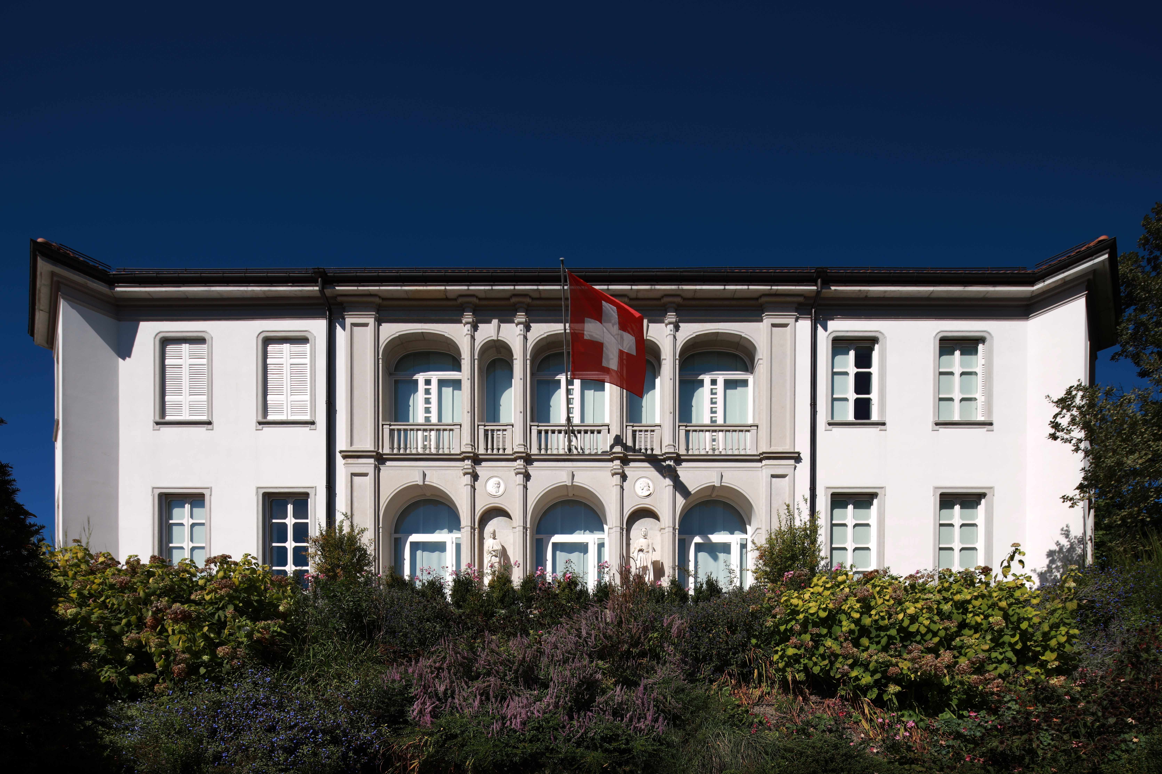
Mediation Culture Inclusion (MCI)
Project
Object: One-day workshop “Close your eyes and open your mind”
Venue and date: Vincenzo Vela National Museum (Ligornetto, Switzerland), 10.11.2016
Goal: to make the collection of 19th century sculptures and paintings accessible to all.
Participants:
team of researchers and university professors;
75 Bachelor's students in Social Work;
8 blind and partially sighted people

Slide 3
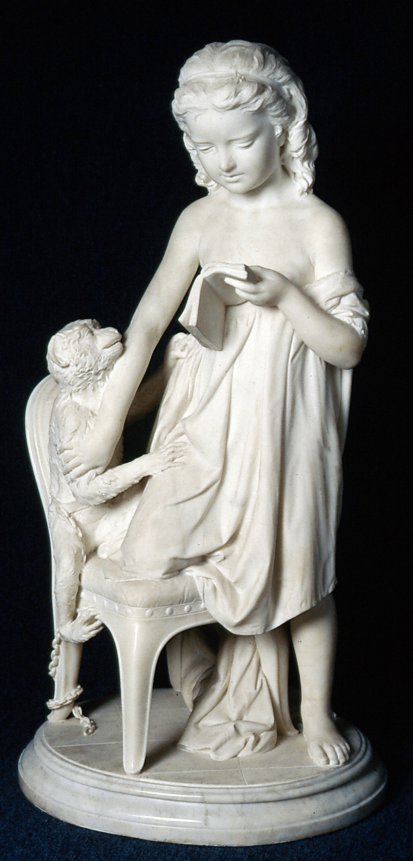
Questions
Can blind and partially sighted people exploit other sensory resources such as hearing to create mental images, even without any visual references?
Is it possible to make a work of art "visible" to people with visual impairments through the use of language and narrative descriptions?
If the answer is yes, which works are most accessible through language?
What information and content should be favoured in constructing the account?
Which aids should be used to effectively convey descriptions to people with visual impairments?

Slide 4
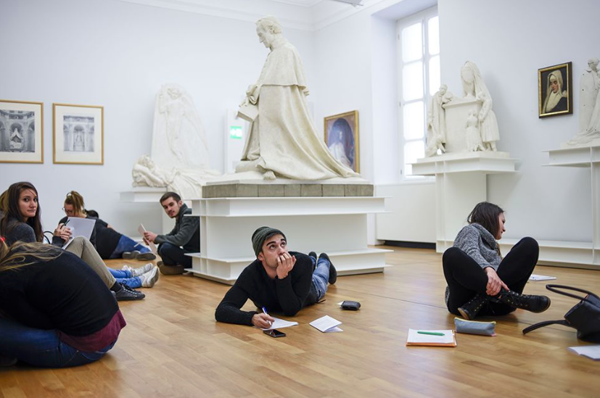
Methods – Phase I
75 students divided into 5 groups (1 group per room). Each person in the group produces a detailed description of the same work aimed at making "visible" a work of art in the collection

Slide 5
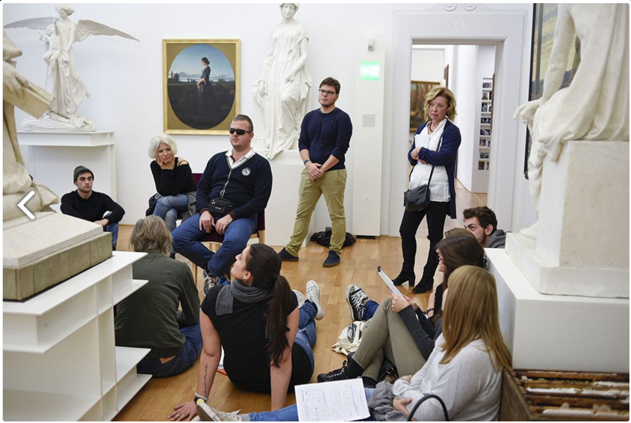
Methods – Phase II
Blind and visually impaired people pass through each group to listen to the work and give advice on how to improve the descriptions.

Slide 6
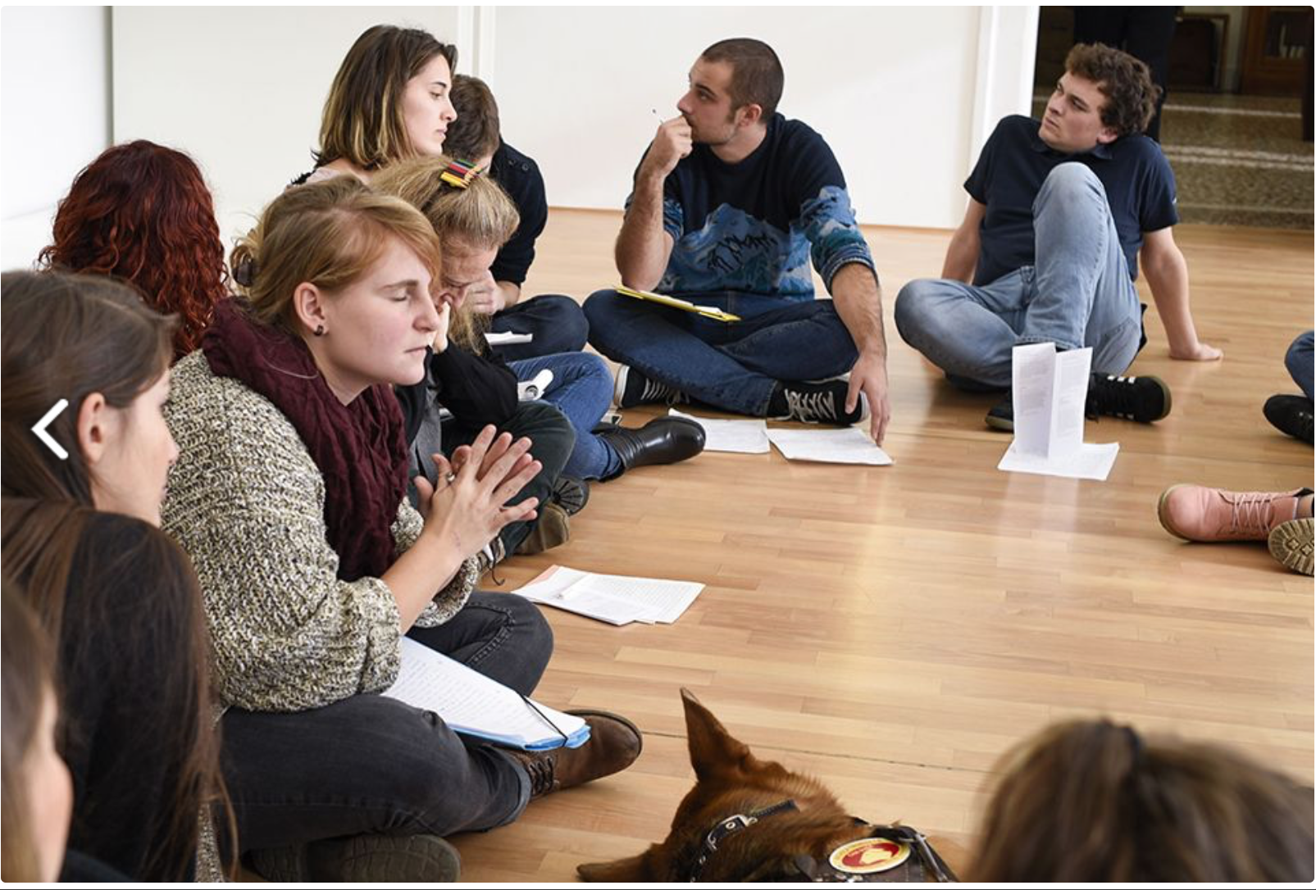
Methods – Phase III
Students choose together the best description to read in the next phase.

Slide 7
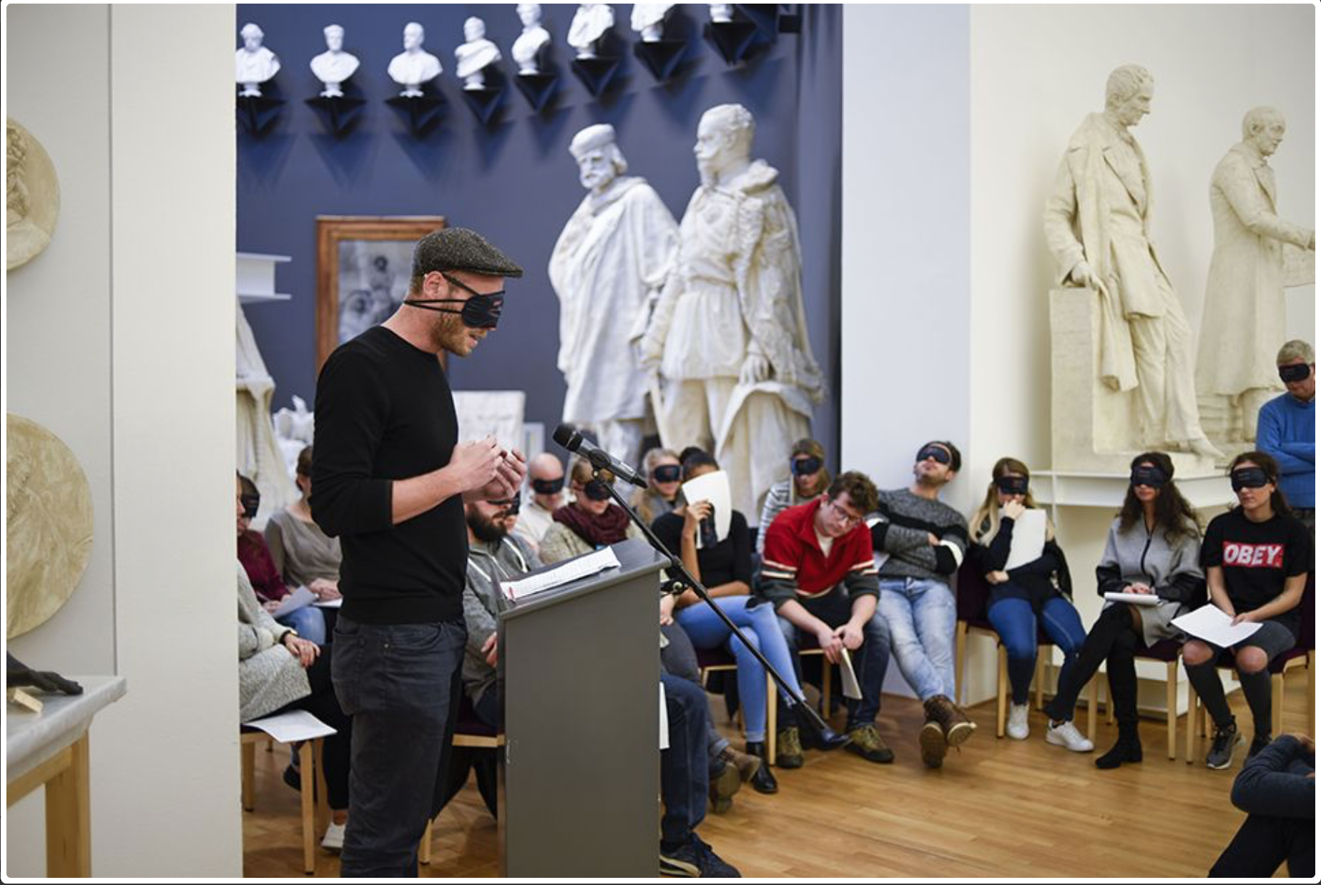
Methods – Phase IIV
Everyone meets up in the big room and, in turn, the 5 selected descriptions are read. Everyone who listens is blindfolded.

Slide 8
Results
Data collection: participant observation and focus group at the end of the workshop
Appreciation
Critical aspects
Experiences
General suggestions
“It is always very difficult to be close to the other, to try to empathize for being resource, support, reference. But the experience of becoming an instrument for others, of reinventing one's own eyes, has really been special”
"Community" dimension;
role of "experts" assigned to blind people
collective reading in the “dark” and imaginary walk through the works of the museum
Receiving descriptive-objectual information
Choice of the adjectives, metaphorical passages and sensory descriptions
cultural guide
historical-cultural information
non-dispersive environment
inclusive events

Slide 9
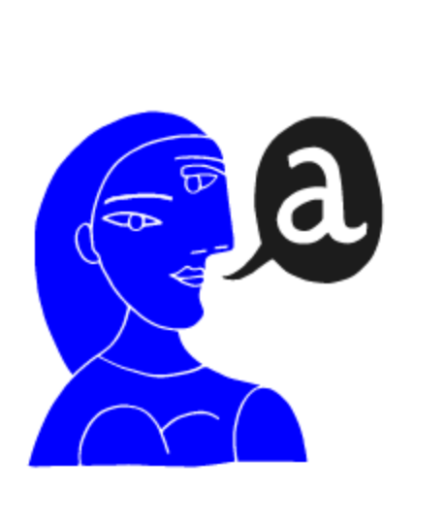
Indications
Select work
Select item
Permanent collection
Representative
Works that can be explored with other senses
By living artists
Multisensory fruition
Location
Spatial context
General information
Biographical hints
Historical and cultural context
Primary subject
Technique, form and composition
Symbolic and evocative commentary
Language
Language register and terminology Taboo words
Rhetorical figures
Adjectives
Orientation
The use of voice
Rhythm of reading

Slide 10
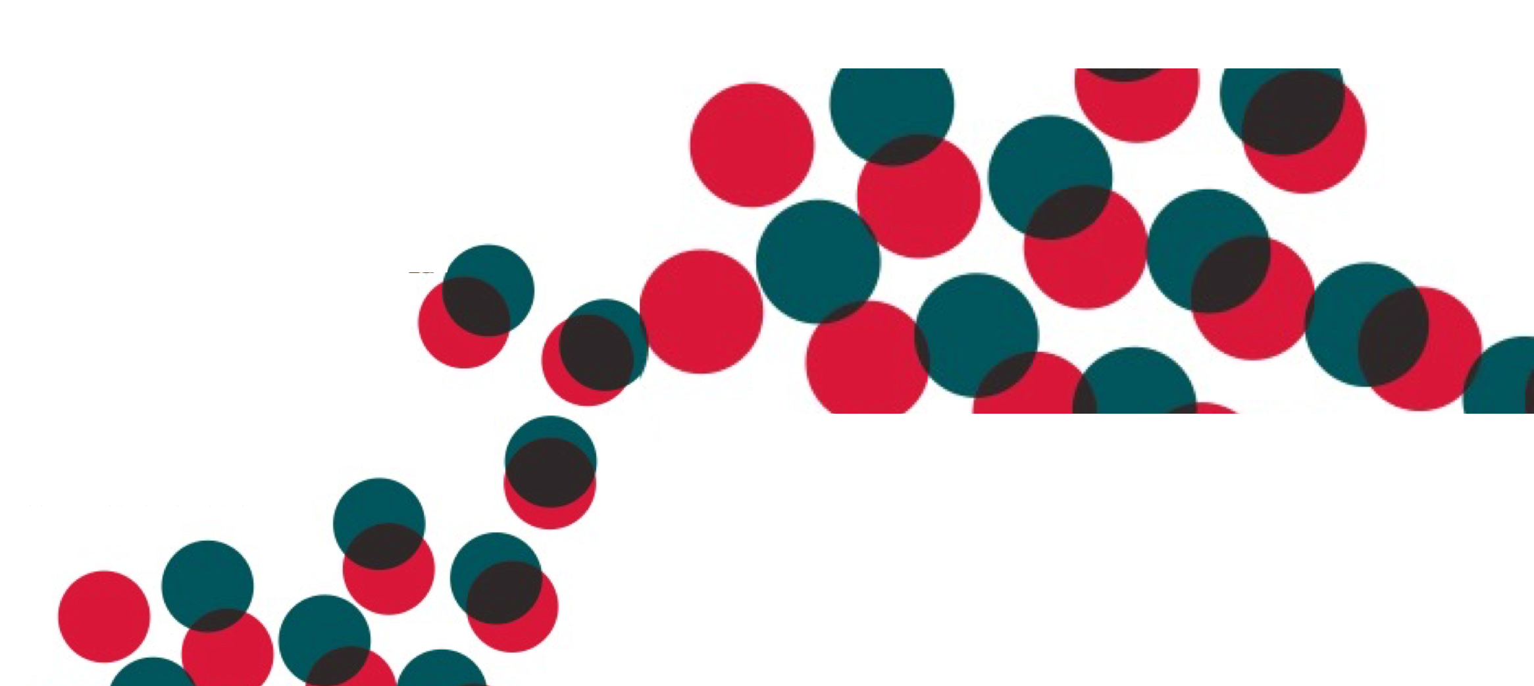
Conclusions
Narrative writing and story telling appeared to be an excellent means to make mental contact with the work, even if they requires particular attention and skill.
Make a selection of works, deepen their analysis, and articulating a narrative using a proper language and structured information allow to make the descriptive work more sustainable and to facilitate the creation of mental images.

Slide 11
Conclusions
The participatory approach of the workshop played a main role in the positive results obtained from participants of the workshop as well as the learning process of students from blind and visually impaired people.
Importance of co-production process in artworks storytelling and narrative writing

Slide 12
Thanks!
Join the Poster Session
Art museums and visual disabilities:
equal opportunities in the cultural
life of Southern Switzerland
Thursday 4 April, 12:30
Pasillo del Hall Principal
Marta Pucciarelli
marta.pucciarelli@supsi.ch

Slide 13
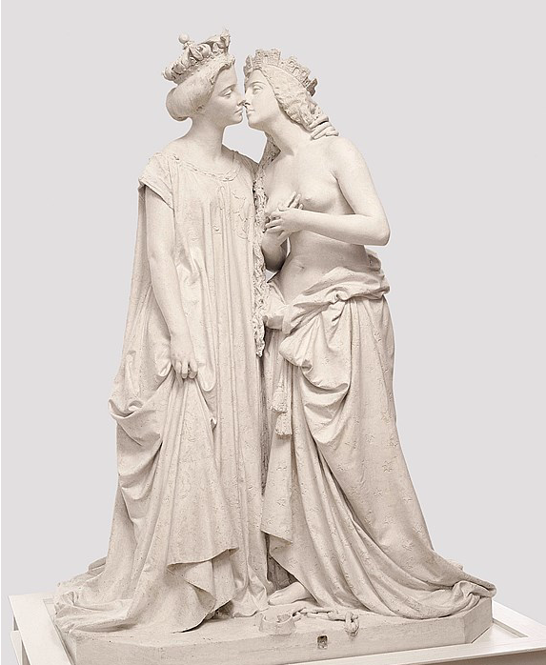
Descriptions
That hand, sweet, pure and light, slowly but surely carried to the chest, is not a thought gesture, it is rather spontaneous, as if it wanted to hold something delicate to itself. It does not try to cover itself, on the contrary, it is perhaps one of those moments that does not even feel the difference of being dressed and naked. She feels the breath of that woman she does not love but admires, her lips are so close that she can feel her breath, still but gentle, almost maternal. The tension of the kiss is subtle, almost non-existent because it is not a kiss of love but a kiss of thanksgiving. The other woman, big and strong, seems indifferent and devoid of feelings but at the same time seems a strict mother who tries to hide the great love she feels.
Cassandra Solari
Vincenzo Vela, ’’L'Italia riconoscente alla Francia’’, 1861-62
Gesso, 199 x 145,3 x 106 cm

